Slide 1
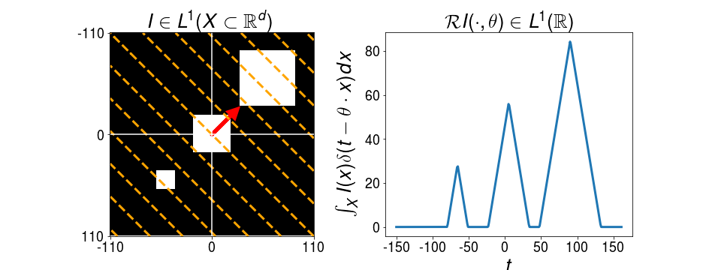
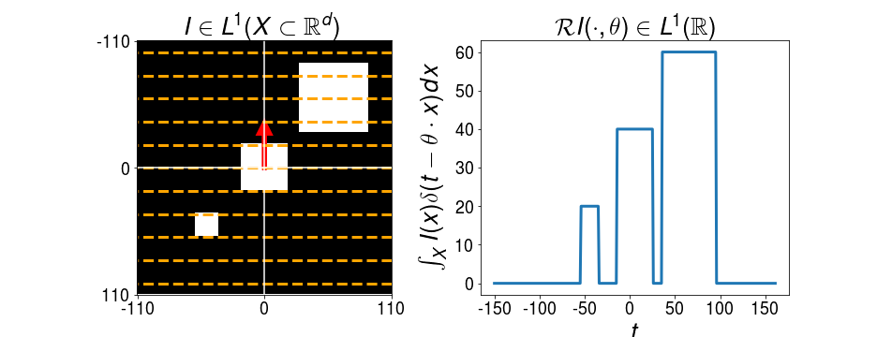
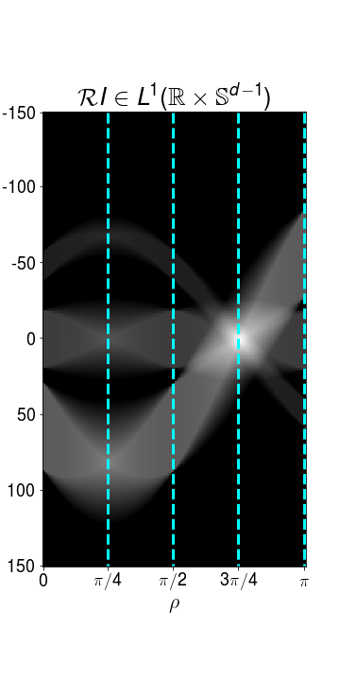
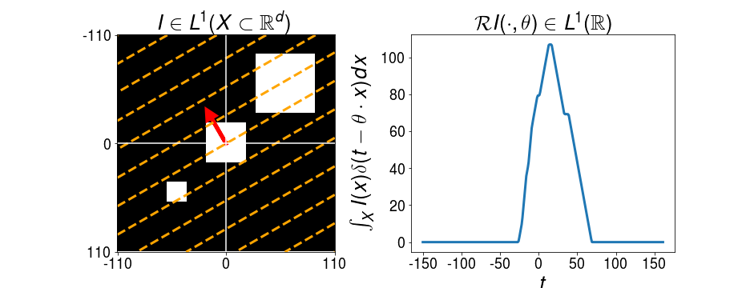
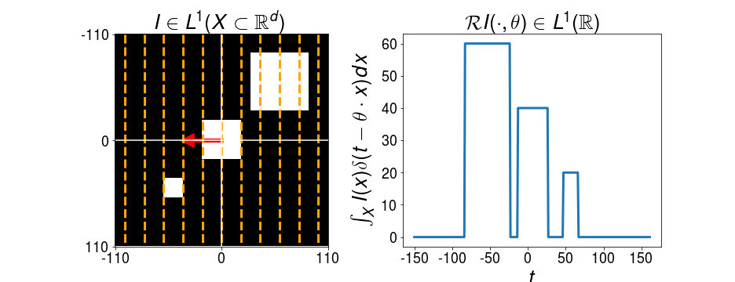




$$ρ=π/4$$
$$ρ=π/2$$
$$θ={\left[\cos\left(ρ\right),\sin\left(ρ\right)\right]}^{T}$$
$$ρ=3π/4$$
$$ρ=π$$
(a)
(b)

Slide 2
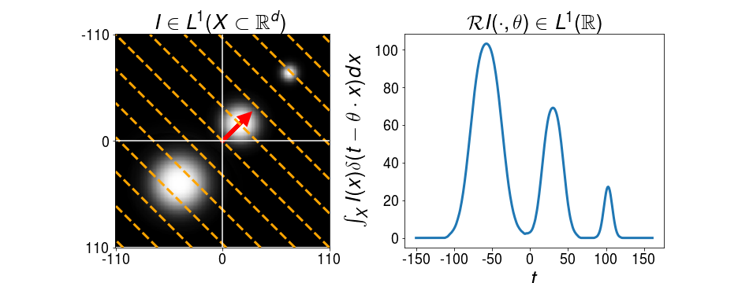
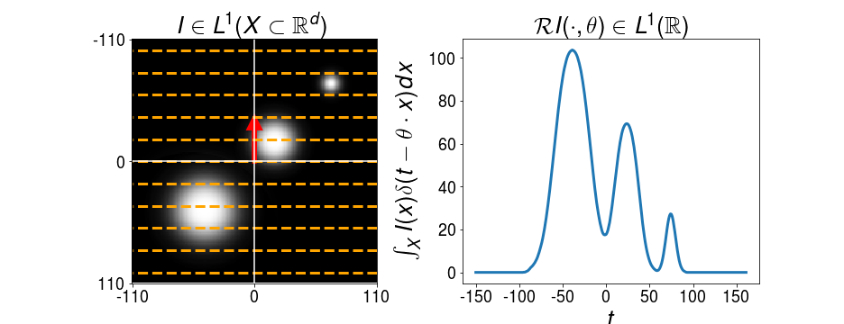
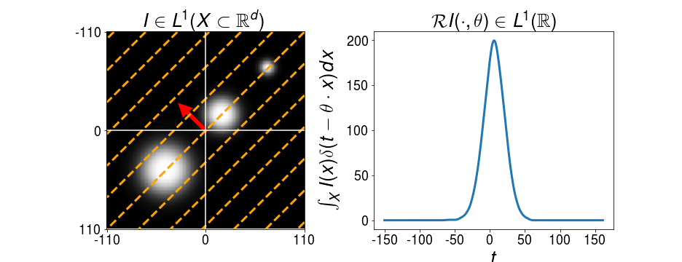
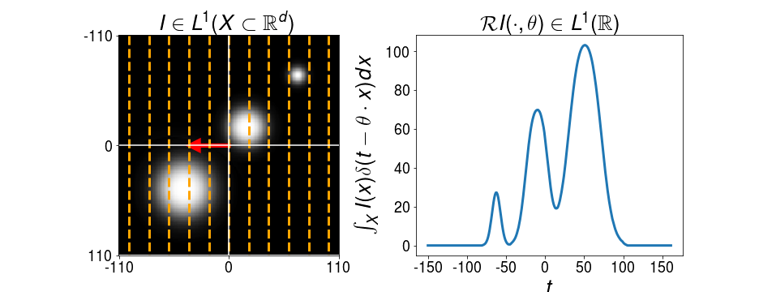



$$ρ=π/4$$
$$ρ=π/2$$
$$θ={\left[\cos\left(ρ\right),\sin\left(ρ\right)\right]}^{T}$$
$$ρ=3π/4$$
$$ρ=π$$
(a)
(b)

Slide 4





Nonlinearity
Leaky-ReLU
Linear Slices
$${∗α}_{1}$$
Integration Along Hypersurfaces
$${∗α}_{2}$$
Final Generalized Slice
$${∗α}_{3}$$
$${∗α}_{4}$$
$${∗α}_{5}$$

Slide 5
Nonlinearity
Sigmoid
Linear Slices
$${∗α}_{1}$$
Integration Along Hypersurfaces
$${∗α}_{2}$$
Final Generalized Slice
$${∗α}_{3}$$
$${∗α}_{4}$$
$${∗α}_{5}$$

Slide 6


Nonlinearity
Sigmoid
Max
Pooling
Linear Slices
Integration Along Hypersurfaces
$${∗α}_{1}$$
Final Generalized Slice
$${∗α}_{2}$$

Slide 8
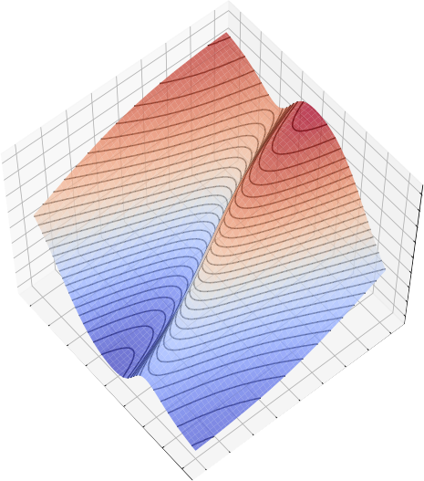
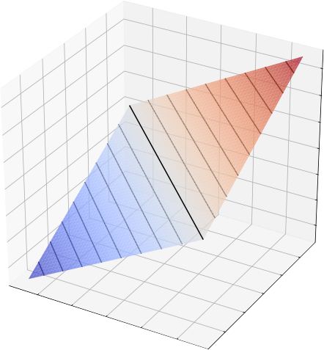
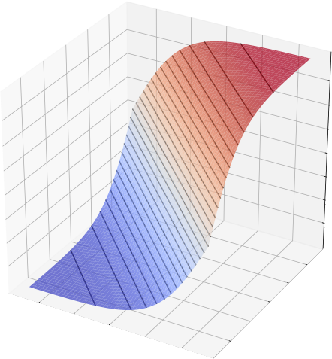
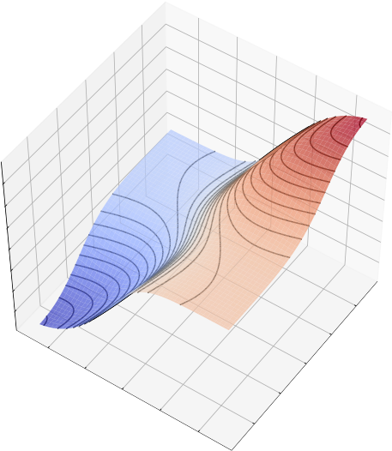









$$Θ^{i}=[θ_{1}^{i},…,θ_{L_{i}}^{i}]$$
Supervised learning setting
Input distribution
$$g_{θ}\left(x\right)=x⋅θ_{1}$$
$$g_{θ}\left(x\right)=σ(x⋅θ_{1})$$
$$g_{θ}\left(x\right)=σ(θ_{1}^{2}⋅σ\left(Θ^{1}x\right))$$
$$g_{θ}\left(x\right)$$
$$g_{θ}\left(x\right)=σ(θ_{1}^{3}⋅σ\left(Θ^{2}σ\left(Θ^{1}x\right)\right))$$
$$p_{X}$$
$$\min_{θ}{−\sum_{i}{y_{i}⋅log⁡(σ\left(g_{θ}\left(x_{i}\right)θ_{1}^{4}\right))} }$$
Level curves
Curve integrals
$$𝓖p_{X}(t,θ)$$
(a)
t
(b)
t
(c)
t
(d)
t

